Slide 1


Slide 2


GROUP -C
Team members
Vaishnavi Sahu K Sai Sudha Aaishu Agarwal Anjali Prajapati Sarthak Bhatt
Team Github Repo-
https://github.com/Ms-Vaishnavi/JEDI-2.0-Flipkart-Development/tree/Development

Slide 3

STAKEHOLDERS
Sponsors:
1.Flipkart
SME’s
1.Amit Kr. Balyan
Training Coordinators:
Sharath Ramesha
Ballimpalli Padmaja Purushotham

Slide 4

Our vision
Our Journey
Engineering Practices
Tech Stacks
Challenges & Learnings
Demo
Questions

Slide 5

To create Flipfit, a Gym
Management System, where -
A Gym owner can add gym, change gym details,get gyms verified
A Customer can view gyms, book slots,cancel slots
Admin can approve gyms and
gym owners

Slide 6


Our Journey

Slide 7

FRAMEWORK FOR 1 WEEK
1 week plan
Everyday Discussion about Technologies and doubt clearance .
Everyday with SME/Trainer discussion of Project progress & transformation based on UML & Technologies.

Slide 8




1
2
3
4
5

Slide 9







Tech Stack

Slide 10

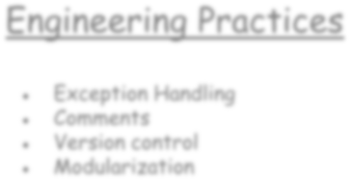
Engineering Practices
Exception Handling
Comments
Version control
Modularization

Slide 11


Challenges & Learnings
Working on a Tight Schedule
Collaborating using Git
Working with New Technologies
Tooling and IDE Challenges

Slide 12


Demo

Slide 13


Questions?

Slide 14

Thank You!

